Slide 1
FERRERO INTERNATIONAL S.A.
FERRERO TRADING S.A.
SOREMARTEC S.A.
New supplier: Welcome Booklet

Slide 2

Dear supplier,
We are starting a new partnership, therefore we have some information to share with you.

Slide 3

Summary
Supplier form
Preinvoice process
Invoicing process
Non-disclosure Agreement

Slide 4
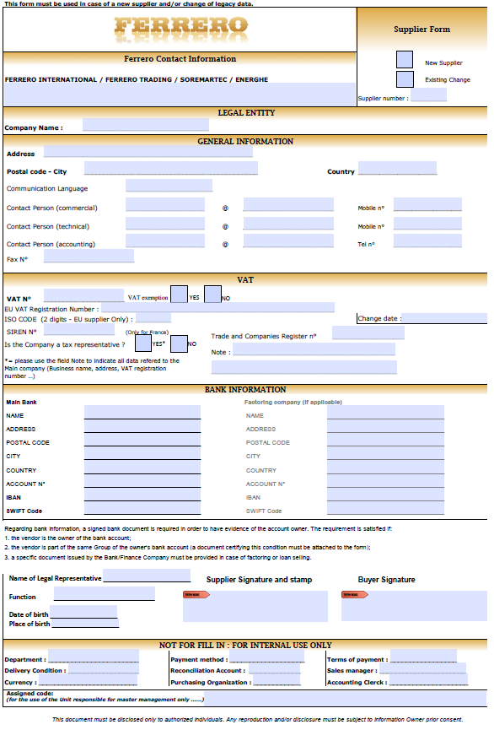


I. Supplier form
Please fill the supplier form (attached below) and send it back to us signed along with a bank certification (document from your bank confirming you are the owner of the given bank account).

Slide 5

II. Pre-invoice process (only for transport)
Ferrero Trading Lux S.A. will send you by mail one pre-invoice, at the latest on
1st and
12th working day of every month. In this document, you will find the list of all trips made during the previous period (last month).
You have to issue one invoice for each pre-invoice.
Moreover the following information must be mentioned on your invoices :
▪ Purchase Order number (e.g. 45700xxxxx)
Shipment numbers (e.g. 5xxxxxx from all origins, except Germany that starts with 2xxxxx).
The price of each transport has to be exactly the one indicated on our pre-invoice.
In case of differences between invoices and pre-invoices, invoices will be blocked and WILL NOT be paid. This will therefore delay payments, and those delays cannot be attributable to Ferrero Trading Lux S.A.
If an error is detected on the preinvoice please contact backofficescftl@ferrero.com and put in copy with the details. Do not send your invoice with a discrepancy.

Slide 6

II. Pre-invoice process (only for transport)
DIFFERENCES
For a difference of price, please contact the procurement team: Lorelei.POPESCU@guest.ferrero.com
Send to Procurement team the excel form here attached, filled in with the requested information:
In case of price difference approval, Procurement team will communicate to you the additional PO nr.
Issue 2 separated invoices:
  One for the amount stated in the preinvoice, mentioning the PO number.
  One for the additional price difference mentioning the additional PO number.
For a transport missing on a pre-invoice, please contact: backofficescftl@ferrero.com

Slide 7
II. Pre-invoice process (only for transport)
EXTRA COSTS
For any additional cost request, you have to fill the excel form and send it to:
backofficescftl@ferrero.com (put your email address)
If the additional costs will be approved, Ferrero will communicate to you a PO nr and you must write this nr on your invoice.
Issue 2 separated invoices:
  One for the amount stated in the preinvoice, mentioning the PO number.
  One for the additional price difference mentioning the additional PO number.
DELIVERY SLOTS MANAGEMENT
This file is explaining how to contact the local people in order to organize the delivery and avoid extra costs.

Slide 8

II. Pre-invoice process (only for transport)
INFORMATION REGARDING DEMURRAGE
Please check your agreement with Ferrero.
Reminder:
Claims for waiting time at loading or unloading will be rejected if no appointement was made.

Slide 9
II. Pre-invoice process (only for transport)
CREDIT NOTE
Each credit note must have written the related invoice number.
The credit note has to be sent with a copy of the invoice in attachment.
In case of credit notes for partial amounts, it is mandatory to add the transport numbers for which the specific credit note has been issued.
Please note that no partial payment will be done. If you are expected to issue a credit note, the invoice won’t be paid before the credit note registration.
Credit Notes can be sent by email to: ftl.pdfinvoice@ferrero.com
or by courier to:
FERRERO TRADING LUX S.A.
PO Box 20
20089 Rozzano (MI)
ITALY

Slide 10

III. Invoicing process : Golden rules
To fasten invoicing posting and payment we kindly ask you to follow these golden rules
Send your invoice by pdf mail (Please read details in next slide)
Use following heading :
Be sure Correct Ferrero Purchasing order number is well mentioned on your invoice (PO nr)
Mention FERRERO VAT number
Mention VAT number of your company
Mention agreed payment condition and methods
Mention correct bank information (IBAN and SWIFT are mandatory)
Ferrero International S.A.
Findel Business Center
Rue de Trèves
L-2632 Luxembourg
VAT : LU17217953
Ferrero Trading Lux S.A
Findel Business Center
Rue de Trèves
L-2632 Luxembourg
VAT : LU15843111
Soremartec S.A
Findel Business Center
Rue de Trèves
L-2632 Luxembourg
VAT : LU26273002

Slide 11


III. Invoicing process : where and how to send your invoice
1- GET REGISTERED TO PDF MAIL PROCESS :
Send enclosed request of accreditation (stamped and signed) to supplierstatement@ferrero.com.
2- SEND YOUR INVOICES BY EMAIL
Only once your confirmation email received , please send your invoices to fintlux.pdfinvoice@ferrero.com or ftl.pdfinvoice@ferrero.com or SOREMLUX.PDFinvoice@ferrero.com
Ferrero International S.A.
Ferrero Trading Lux S.A
Soremartec S.A
Invoices cannot be send directly to Luxembourg
Any invoice send to Luxembourg won’t be registered
All invoices sent by postal mail will be refused !

Slide 12
III. Invoicing process : How to follow payment statement
1- GET REGISTERED TO VENDOR PORTAL
Ask your login by email to supplierstatement@ferrero.com. In your email, please mention Full name of your company, Ferrero vendor number of your Company and Email to be used for the account creation.
Then Wait for the Ferrero confirmation email which will provide you Login details to access to the portal and Navigation guide giving an overview of portal key functionalities
2- CHECK ON FERRERO VENDOR PORTAL, STATEMENT SECTION :
Search and verify the status of documents issued by your company payments (invoices, credit/debit notes) within the last 3 months and ask for clarification directly.
NOTE: the database is updated on a daily basis with the information every night
Please contact supplierstatement@ferrero.com for any issue

Slide 13

IV. Non-disclosure agreement
The Non-Disclosure Agreement (NDA) is a mandatory document requested for any new supplier intending to exchange confidential information or visit some critical zones and must be signed by both parts .
Please fill in the template attached below and send it back to us duly signed.

Slide 14
V. General conditions European tender (only for land service)
Please read carefully this file for more details about security, quality and general information.

Slide 15
Thank You

